Slide 1
Case 1: TIA/Duodenal Ulcer/Osteoporosis
Patient case: Mrs. Williams is a 76 year old female, height 172cm, weight 70kg, BMI: 23.7
Current problems: Transient Ischemic Attack (TIA), Duodenal Ulcer (DU)
Current medications:
Aspirin: the patient is on aspirin for secondary prevention of stroke, due to TIA 13 years ago.
Nexium, a Proton Pump Inhibitor (PPI): because she had duodenal ulcer 4 years ago due to aspirin, the patient is on PPI to protect the duodenum and prevent ulcer bleeding,.
New problem: Osteoporosis
Management scenario: The patient presented recently with back pain. Earlier lumbosacral X-ray showed no vertebral fracture and the physician decided to follow primary care recommendations to evaluate risk for osteoporosis fractures, and thus ordered a DXA bone mineral density scan.
Osteoporosis was confirmed (DXA shows bone marrow density of -2.6. FRAX assessed and risk of second fracture is >20%). The recommended blood tests were ordered (including electrolytes, vitamin D, thyroid function, protein electrophoresis, CBC, and metabolic panel) to rule out additional reasons for secondary osteoporosis. All blood tests were normal. The patient does not have conditions that may be a secondary cause such as Diabetes or Celiac or a family history of them.
Another possible secondary cause of osteoporosis is Nexium (PPI).

Slide 2
Clinical Guidelines
Guidelines for the Prevention of Stroke in Patients with Stroke and Transient Ischemic Attack, 2014, Stroke. LINK
Management of Patients with Ulcer Bleeding, 2012, American Journal of Gastroenterology. LINK
Clinical Practice Guidelines for the Diagnosis and Treatment of Postmenopausal Osteoporosis. 2016, Endocrine Practice. LINK

Slide 3
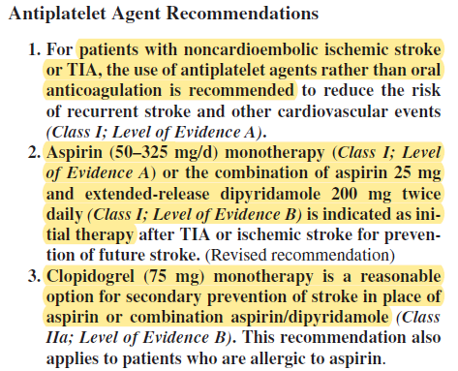
Clinical Guidelines: Highlighted Parts (1 of 3)
Guidelines for the Prevention of Stroke in Patients With Stroke and Transient Ischemic Attack
Management of Patients with Ulcer Bleeding
[1] p. 2198
[2] p. 347
29. In patients with low-dose aspirin-associated bleeding ulcers, the need for aspirin should be assessed. If given for secondary prevention (i.e., established cardiovascular disease) then aspirin should be resumed as soon as possible after bleeding ceases in most patients: ideally within 1 – 3 days and certainly within 7 days. Long-term daily PPI therapy should also be provided. patients (Conditional recommendation).

Slide 4
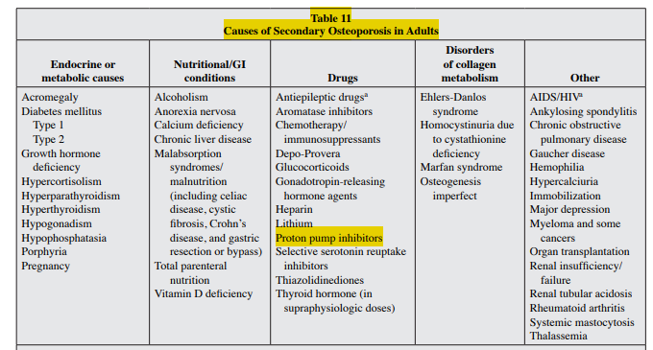
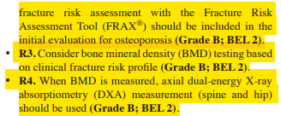

The Osteoporosis guideline – ( 2 of 3)
[3] p. 12
[3] p. 2
[3] p. 3

Slide 5
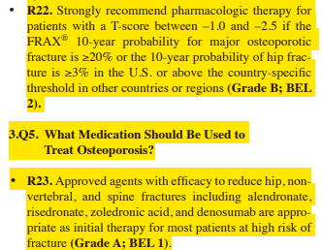
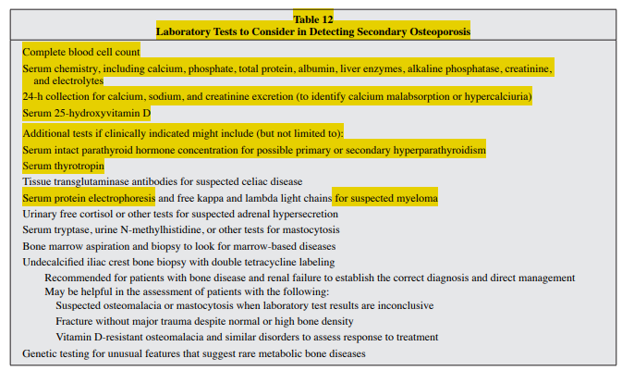
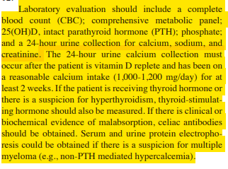
The Osteoporosis guideline - (3 of 3)
[3] p. 4
[3] p. 13
[3] p. 12

Slide 6
Domain knowledge
Knowledge | Sources
Aspirin and Clopidogrel are platelet aggregation inhibitors | ATC (Anatomical Therapeutic Chemical) classification. World Health Organization. LINK
Aspirin is an NSAID (Non-steroidal anti-inflammatory drug) | ATC
In the CVD guideline, aspirin or clopidogrel are given to reduce the risk of stroke | [1]
Aspirin may cause duodenal ulcer | [2]
Nexium is a Proton-pump Inhibitor PPI | ATC
PPI inhibits gastric acid secretion | [2]
PPI may contribute to secondary osteoporosis | [3] Table 11
Alendronate, risedronate, zoledronic acid, teriparatide, or denosumab reduce the risk of fracture | [3] R23
Notes:
This slide shows the first-principle pieces of medical knowledge that can be used to support decisions for the given use case, paired with their sources. In particular, from the ATC classification, we know that clopidogrel is a platelet aggregation inhibitor (first row), such as Tirofiban, Ticagrelor and Prasugrel (sixth row). This kind of knowledge can be obtained exploiting repositories such as ATC (maintained by the WHO), SNOMED CT or DRUGBANK.
Platelet aggregation inhibitors may increase the risk of bleedings (third row). I have not specified a knowledge source for this information (such as for the fact that also surgery increases the risk of bleedings), because they represent basic medical knowledge.
From the CAD guideline, we also know that the dual antiplatelet therapy (see row 2) is given to prevent thrombosis (i.e., to reduce cardiovascular risk). Often, this kind of information is contained in the guidelines (but it often corresponds to the indications of the drug in DRUGBANK).
Finally, one can also exploit knowledge about the duration of the effects. Usually, such a kind of knowledge can be derived from pharmacodynamics and pharmacokinetics studies. For instance, for our case study, it can be useful to take into account that the effect of clopidogrel lasts about five days (row 4), while the effect of tirofiban is 4-8 hours (see row 7).

Slide 7
Mitigation of Adverse Interactions
Adverse interactions
PPI is possible secondary cause for osteoporosis
Drug (PPI) may be causing a comorbid condition (Osteoporosis)
Suggested treatment
Replace aspirin with clopidogrel for secondary prevention of stroke
Stop PPI to prevent (worsening of) osteoporosis; no longer needed since aspirin was replaced
Add alendronate, risedronate, zoledronic acid, teriparatide, or denosumab to reduce the risk of fracture.
Alternative option 1:
keep current treatment of aspirin+PPI, with risk of osteoporosis progressing
Add alendronate, risedronate, zoledronic acid, teriparatide, or denosumab to reduce the risk of fracture.
Alternative option 2:
Stop PPI, with risk of DU returning;
Add alendronate, risedronate, zoledronic acid, teriparatide, or denosumab to reduce the risk of fracture.
Relevant aspects
Level of evidence for treatment (e.g., aspirin vs. clopidogrel)
Clinician preference and experience
Patient burden and preference (e.g., number of medications)

Slide 8
Features for decision support
 | - type of interaction
A1 | Drug from a CPG has an effect on a comorbid condition (including ADE) | Aspirin affects DU; PPI affects Osteoporosis
A3 | Clinical goals from different CPGs may conflict | Give PPI to prevent DU vs. Stop PPIT to prevent Osteoporosis form progressing
A4 | Conflicting actions (e.g., drugs, procedures) from different CPGs | PPI (DU guideline); Stop PPI (Osteoporosis guideline)
A7 | Multiple interactions from different CPGs occurring at the same time | DU evolved due to Aspirin; Osteoporosis evolved later
 | - types of mitigation
B1 | Adding a drug to mitigate an adverse effect | Add PPI to avoid DU
B4 | Replacing a drug with a safer / non-interacting drug / more effective drug for comorbidity | Replace Aspirin with Clopidogrel
B5 | Discard unsafe/interacting drug | Discard PPI
 | - Other features
C1 | Patient preferences and/or patient burden | Secondary prevention of CVD/stroke; Secondary prevention of DU; Prevention of secondary osteoporosis (due to PPI) Treatment of Osteoporosis
C4 | Alternative mitigation strategies for a single interaction | 3 possible treatments

